Slide 1
Formatting a Thesis or Dissertation
Karen L. Greene, PhD
Director, Graduate Admissions & Student Service
September 2019

Slide 2
Guidelines
Before anything else, prepare...
Guidelines
https://www.uakron.edu/gradsch/docs/gdln.pdf
MicroSoft Word Template
https://www.uakron.edu/gradsch/docs/gdln.pdf
If you have questions, please reach out to me (greene@uakron.edu)

Slide 3
Why Formatting
High standards of presentation
Standards are applied consistently to all departments and programs
Precise and complete presentation
Future publications

Slide 4
Page Format / Margins
Correct margins are:
Left side 1.5”
no exceptions
Right side 1.0”
no exceptions
Top 1.0”
exception: pages that carry major headings, such as preliminary pages and chapter titles, must have a 2.0” top margin
Bottom 1.0”
exception: when the last page of a chapter
Figures and tables must fit within the margins

Slide 5
2” top margin
1.5” left margin
1” right margin
Incorrect

Slide 6
Widow/Orphan Protection
Pages should be spaced so that no page ends or begins with a single line of text.
At least two lines of a paragraph must appear together at the top & bottom of every page

Slide 7
Widow/Orphan

Slide 8
Spacing
Text material is double spaced throughout.
Do not insert extra blank lines or spacing to separate text.
Single spacing may be used in:
figure/table titles
long quotations (properly indented)
notes
bibliography/references section

Slide 9
Typeface, Justification, Centering & Paragraphing
Fonts
MUST be consistent throughout the manuscript
Most fonts are acceptable, however San Serif is preferred
Font size must the same size throughout (12 pts preferred)
The maximum font size is 12 points
Unusual or scripted fonts are not acceptable
Do not use bold font for major titles or figure/table titles
The left margin must be justified
Right margins may be full justified if the department/college approves
Note: This may result in unsightly white spaces between words that are not acceptable.
Indent the first line of every paragraph consistently (5 spaces preferred)

Slide 10
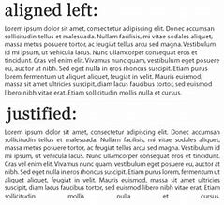

Slide 11
Page Numbering
Preliminary pages are in Roman numerals (i, ii, iii)
Title page is page i.
It is counted but not shown on the actual page
The signature page is page ii.
It is counted and the page number is shown on the page.
Text pages are in Arabic numerals (1, 2, 3, etc.)
Beginning with page 1 of Chapter I, all following pages are numbered sequentially through the end of the manuscript.
Page number embellishments are not permitted (1a, 1b, etc.)
All pages have the page number placed at the bottom of the page, centered under the text at the 1” bottom margin.

Slide 12
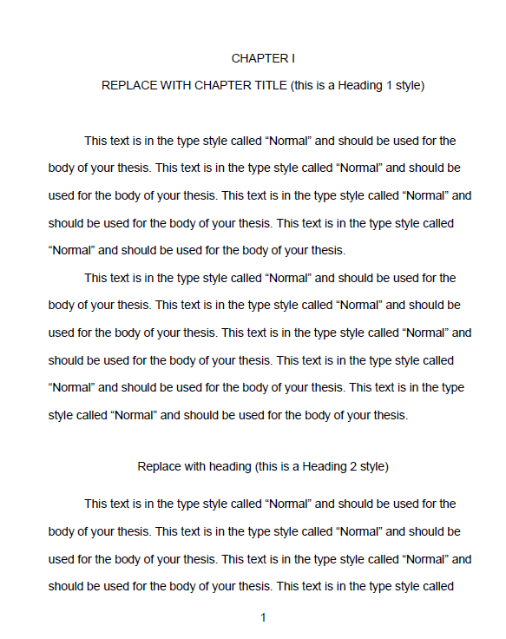

Slide 13
Manuscript Organization
Copyright Notice (optional) (not counted or numbered)
Title Page (counted, not numbered)
Signature Page (page ii)
Abstract
Dedication (optional)
Acknowledgements (optional)
Table of Contents
List of Tables (as needed)
List of Figures (as needed)
List of Illustrations (as needed)
List of Schemes (as needed)
Chapters (begin Arabic page numbering, I, II, III, IV, V)
Bibliography
Appendices

Slide 14
Title Page
All text on this page is centered
Double space the entire page
The top margin is two-inches (2”)
Title
Must be in all capital letters
Must be centered immediately below the two-inch top margin
Graduation date
Must be month, year of graduation (May, August or December only)
Title page is counted as page i
However, this page number is not shown

Slide 15
Title Page

Slide 16
Signature Page
Title
All capital letters
Centered immediately below the two-inch top margin
Double spaced if two or more lines
Author’s name
Case sensitive (not all caps).
Signature page is counted as page ii
The names of those signing are typed a single space below their titles
Use “Dr.”, “Mr.”, “Mrs.”, before all names

Slide 17
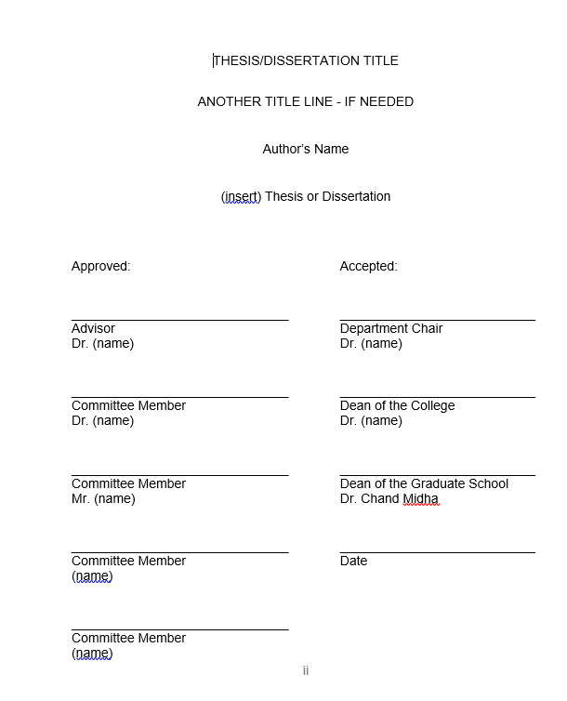
Signature Page

Slide 18
Table of Contents (TOC)
All entries in the Table of Contents must match exactly as they appear in the text including: wording, numbering, punctuation, capitalization and spelling and page number on which they appear
Preliminary pages that occur before the TOC are not included
Preliminary pages that occur after the TOC are included (e.g., List...)
Include the word “CHAPTER” after the last preliminary listing and above the first chapter listing
Chapter titles are typed in all capital letters and use Roman numbers
Subheadings are case-specific
Double Space between entries
Single space within an entry if it falls on two or more lines

Slide 19
Table of Contents (cont’d)
Chapter numbers
Roman numerals (I, II, III, IV, V)
Left-aligned
Indenting should be consistent basis
If there is only one appendix, label it as APPENDIX.
If there are multiple appendices, label it as APPENDICES
Appendices should be labeled as APPENDIX A, APPENDIX B, etc. including titles in all caps.

Slide 21
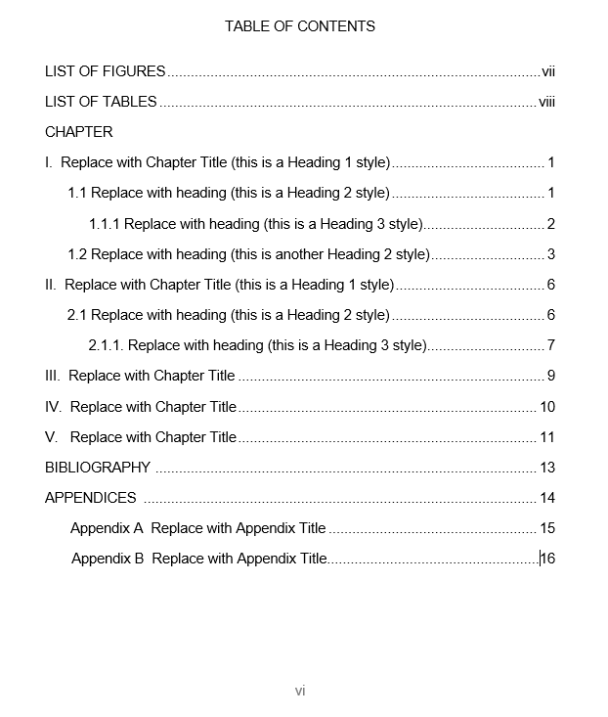

Slide 22
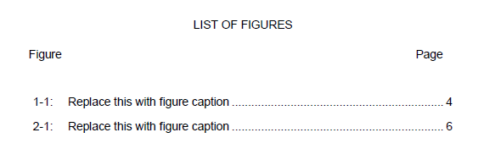
TOC: List of Tables and List of Figures
“Figure,” “Table, ” or the appropriate heading is typed above the number designation column (left).
Type “Page” (right)
Do not type “heading label” before every entry

Slide 23
TOC: List of Tables and List of Figures
All entries in List of Tables, List of Figures, etc must match exactly as they appear in the text, including: wording, numbering, punctuation, capitalization and spelling and page number on which the table/figure appears.
Exception – if the description is too long, you may opt to include only the first full sentence of the description.

Slide 24
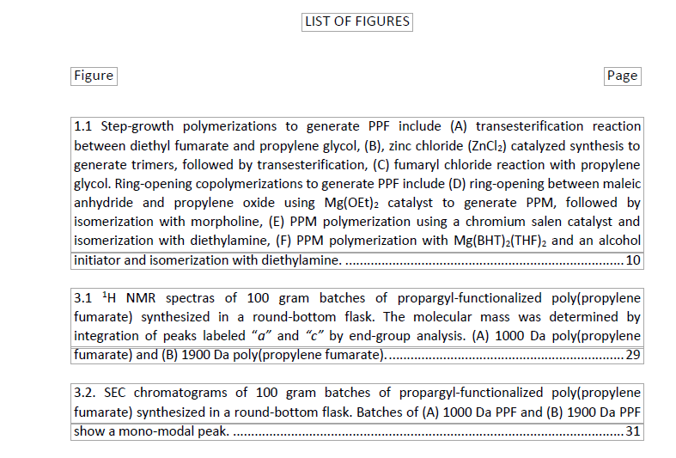
TOC: List of Tables and List of Figures

Slide 25
TOC: List of Tables and List of Figures
Do not use combinations of letters and number for your table/figure designations.
Example: If working in Chapter 4
Do Use: 4.2, 4.3, 4.4
Do Not Use: 4A, 4B, 4C

Slide 26
Tables / Figure with the Text
Table titles appear above the table
Figure captions are to be placed below the figure
Do not bold any part of the title or caption
Each must be numbered consecutively in Arabic numbers
Landscaped entries are acceptable

Slide 27
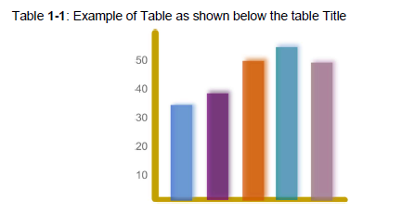
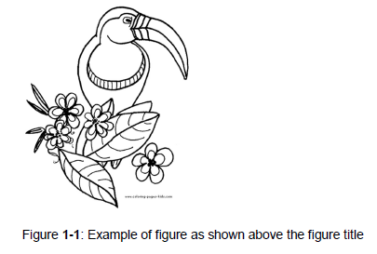
Tables / Figure with the Text

Slide 28
Body of the Manuscript / Text
This begins the Arabic page numbering (1, 2, 3)
Page numbers are centered at the 1” bottom margin
All text is double spaced throughout
At least two lines of text must appear at the top and bottom of each page
Remember: No widows/orphans

Slide 29
Body of the Manuscript / Text
All subheadings must be followed by at least two lines of text
Page margins
1” for top
except: top margin on chapter title pages (2”)
1.5” left
1” right
1” bottom

Slide 30
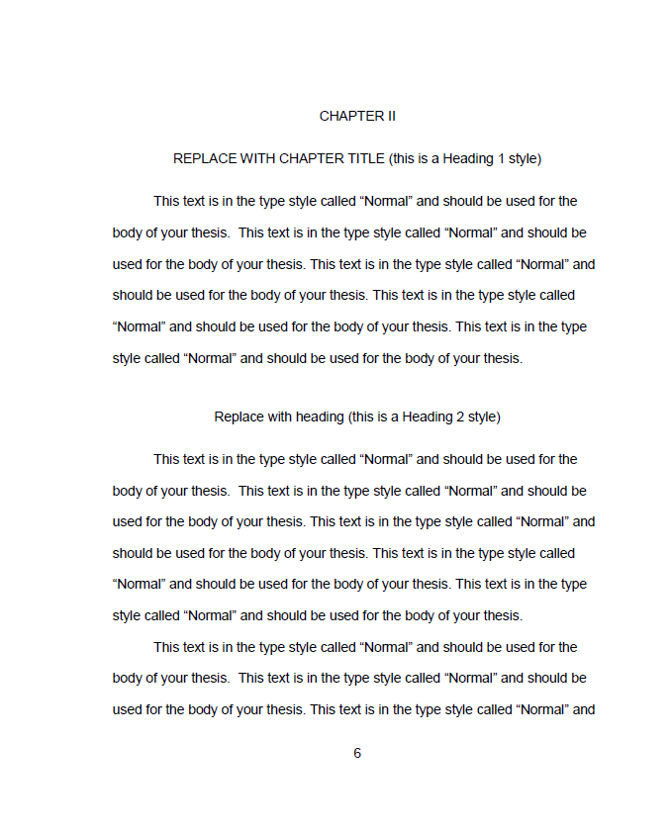
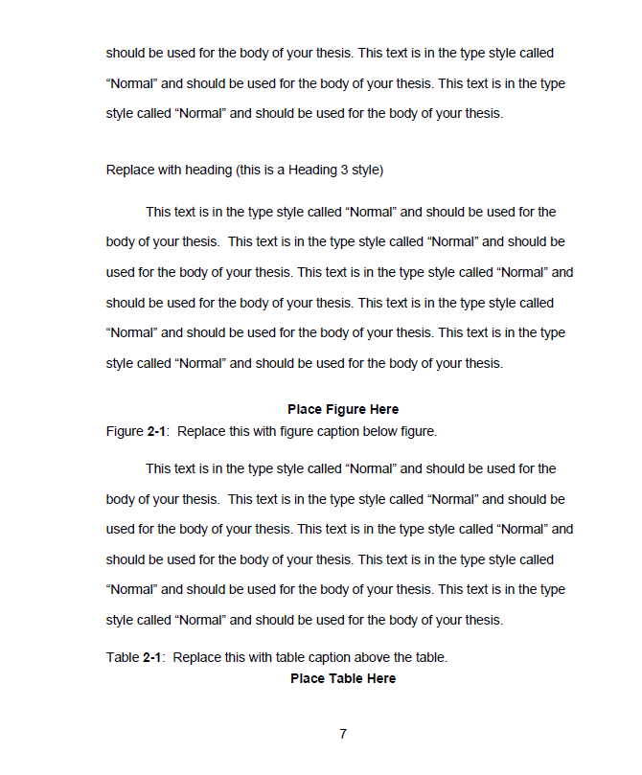

Slide 31
Chapter Title Pages
A chapter title page is the start of a new chapter.
All chapter title pages have a 2” top margin
All chapters start with its own separate page
CHAPTER I, II, III, etc. is typed in all capital letters without punctuation, centered between the margins

Slide 32
Chapter Title Pages (cont’d)
The chapter title is typed in all capital letters two spaces below the heading, centered between the margins
Should the title be more than one line, it will be double spaced
Text of the chapter begins three spaces below the chapter title
If a subheading follows a chapter title, it is placed three spaces below the chapter title
Text is then two spaces below the subheading

Slide 33
Chapter Title Page

Slide 34
Bibliography, References or Literature Cited
REFERENCES or BIBLIOGRAPHY - all caps & centered
2” top margin
Page numbering continues in Arabic numerals
Single space within entries with double space between entries
Lists ALL sources used in your work

Slide 35
Appendices
The material must be set up like a new section
If there is only one appendix
APPENDIX centered below the 2” top margin
Text/material to follow three spaces below
If there are two or more appendices
Each appendix should be treated as a separate section with its own title page
Labeled Appendix A, Appendix B, etc.
Be sure to add the individual appendix titles in the TOC .
A division page is inserted before Appendix A
The word APPENDICES will be centered between the margins, slightly above the center of the page
Page number placement continues as in text
This page will appear in the TOC as well

Slide 37
Format Checking
If at any time you have questions, please contact me.
greene@uakron.edu
330-972-2135

Slide 38
Electronic Submission Procedures
Uploading your ETD to OhioLink
https://etdadmin.ohiolink.edu

Slide 39
Format Checking and OhioLINK
Please note your manuscript will not be visible to the public when you upload it to OhioLink. It will only be visible to me.
Your manuscript will be released for public view after your degree has been conferred by the University Registrar. Exception: When a delay of publication has been submitted

Slide 40
Delay of Publication
How To: (2 step process)
Enter the delay of publication information to OhioLink when you upload your manuscript.
Complete and return the Delay of Publication Form (https://www.uakron.edu/dotAsset/677911.pdf

Slide 41
Important Dates

Slide 42
Questions and Contact Information
Karen L. Greene, PhD
Director, Graduate School & Student Services
Graduate School | Leigh Hall 515
greene@uakron.edu
330-972-2135

